Slide 1

Hmonics
All Day Every Day
Cheng | Derick | Jared | Philip
Notes:
Cheng

Slide 2
System Overview
A Global Culture Needs Global Tools
As our planet becomes more interconnected with emerging technologies, cultures throughout the world are gradually advancing their education systems to support a more global and diverse way of life. Not only are students today surrounded with children of multiple ethnicities, they are exposed to their ways of life and hopefully encouraged to embrace their differences. The need for tools to enable our youth to accept and nourish this global culture is ever-expanding.
Classroom Tech and Gamification
Technology in the classroom, while controversial in some respects, certainly has benefits to some subjective degree. The tools that have helped our world diversify can also facilitate our abilities to support a new global culture. Mobile technology has proven to be one such tool that can not only captivate the minds of young learners, but also integrate comprehensive applications that may involve substantial curricula such as learning a second language.
Project Summary
In particular, the applications used to facilitate learning the Hmong language are sparse, especially in the areas of young children and phonics. As a team, we’ve identified a specific need for one such tool that can not only teach kindergarten-aged students how to speak and spell the Hmong language, but also report progress issues and milestones. Our goal is to develop a phonics tool for teachers of bilingual classrooms with the hope of extending developments to include more users like parents, to allow sharing progress with peers, and to possibly expand into games and apps for other languages that could benefit from such features.
Notes:
Cheng

Slide 3

Key Features
Students learn how to spell and say simple words in the Hmong language.
Playing a game makes the intricacies of English to Hmong easier to understand.
Rewarding animations keep children interested.
Uses a drag and drop interface for easy learning.
Students can see their progress of how many words they have spelled.
Teachers can create profiles for their students.
Teachers can view a report of each student’s progress.
System is available on both popular mobile platforms.
Notes:
Jared

Slide 4
Capabilities
Students Learn Phonics
Students learn how to spell a word.
Students hear what the word sounds like.
Play a Game
Students are given a word to spell.
Students create the word from given letters.
Animations
An animation plays when a letter is put in the right spot.
An animation plays when a word is completed.
Drag and Drop Interface
Students drag letters into their correct spot.
Notes:
Jared

Slide 5
Capabilities
Student Progress
Students see their progress while playing the game.
Each student has a history of their game time.
Student Profiles
Teachers can create student profiles.
Profiles store a history of student progress.
Teacher Reports
Teacher can see each student’s progress.
Available on Mobile
Available on iOS and Android.
Made for tablets.
Notes:
Jared

Slide 6
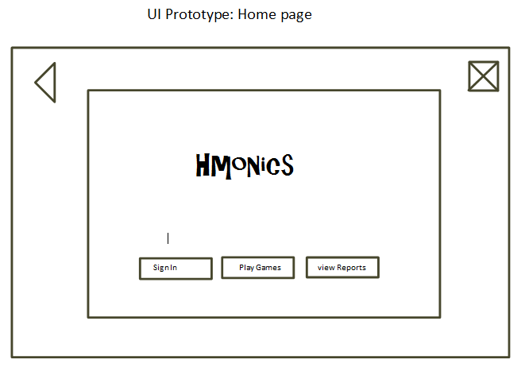
Notes:
cheng

Slide 7
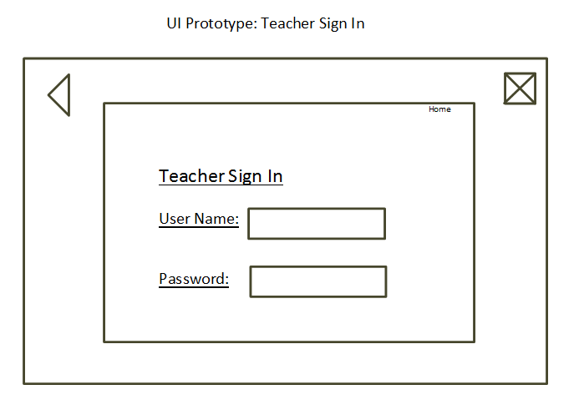
Notes:
cheng

Slide 8
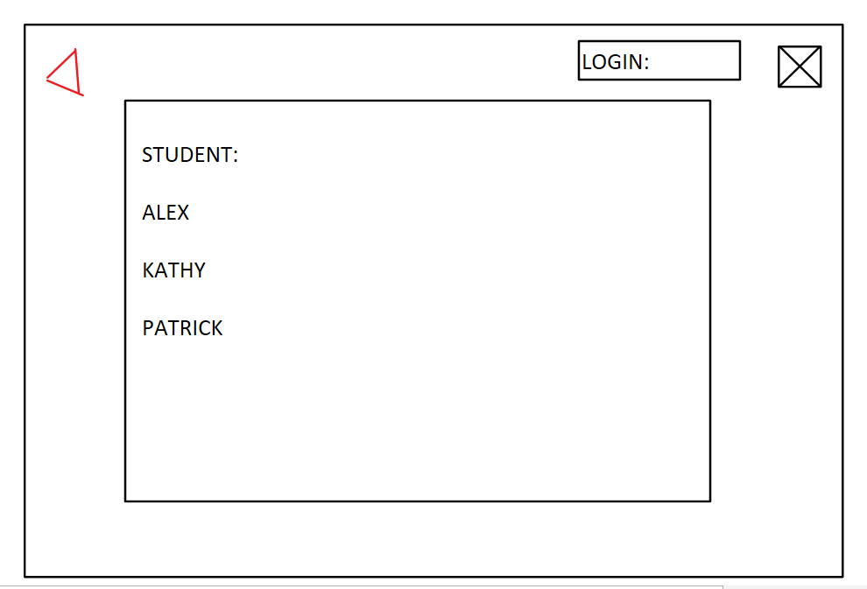
Teacher Screen
Notes:
cheng

Slide 9
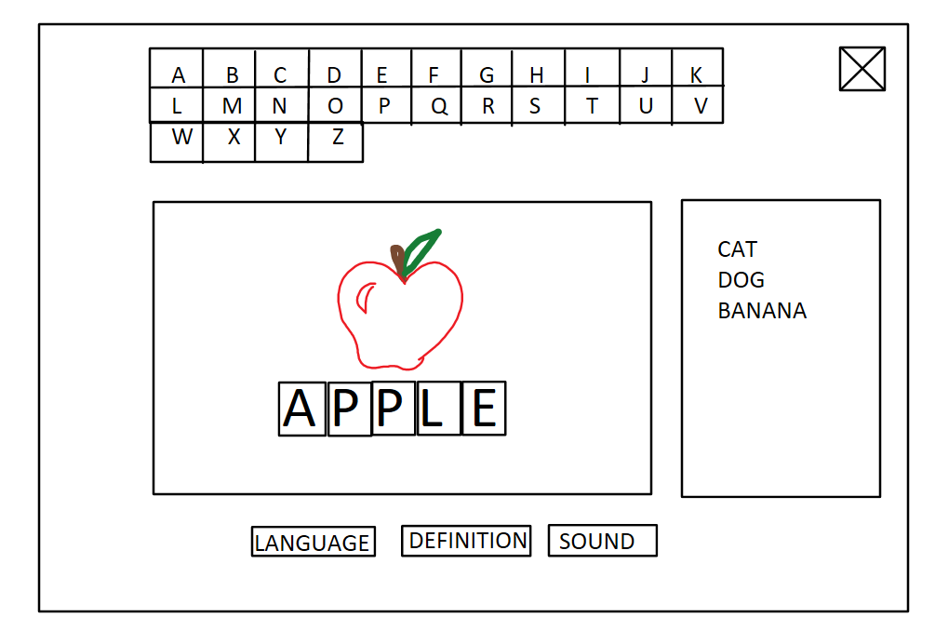
Student Screen
Notes:
cheng

Slide 10
Actor Summaries: Student
Students use the system as a learning tool to learn the phonics of a language. They are given the program to use by a teacher in a language learning class.
They value:
Ease of use
Speed
Fun
Notes:
derick

Slide 11
Actor Summaries: Teacher
Teachers give the system to a student as a learning activity. They start the system for the student. They also can view a student’s progress through the system.
They value:
Reliability
Speed
Accuracy
Fun
Notes:
derick

Slide 12
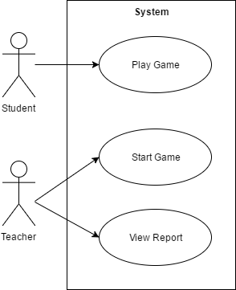
Use Case Diagram
Notes:
derick

Slide 13
Non-Functional Requirements
Platform
<PLA1> The software shall function on Windows, Android, and Apple iOS.
Availability
<AVA1> The software shall save the current state to prevent data loss on any unforeseen power or system failure.
<AVA2> The software shall load the system state correctly on startup.
Security
<SEC1> The software shall prevent unauthorized viewing of a student’s progress.
Notes:
philip

Slide 14
Non-Functional Requirements
Usability
<USE1> The software shall not take more than 10 minutes for a student to learn how to play and navigate through the windows.
<USE2> The software shall display instructions for the students about the game.
Speed
<SPD1> The software shall not take more than 10 seconds to be launched.
<SPD2> The software shall not have a noticeable response time for user actions.
Notes:
philip

